Slide 1
Beautifully Bound (1953)
The first Kinbaku photo-book

Slide 2
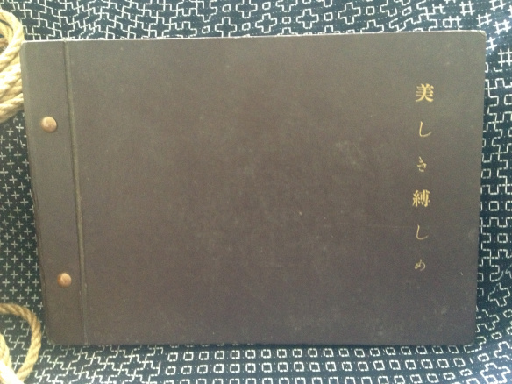
Beautifully Bound (1953)

Slide 3
Early Kinbaku publishing
In the summer of 1953, the first ever Kinbaku photo-book was published in Japan, in an edition of 500 copies.
Each volume was a hand made, hard bound album with 16 photographs, glued onto the page, facing a page of rice paper with an accompanying text.

Slide 4
Rope: Minomura Kou
The rope in Beautifully Bound was done by Minomura Kou (1920–1992).
Minomura, a pioneer of Kinbaku, was a friend and student of Itoh Seiu. In addition to his tying, he was also an artist, using the name ”Kita Reiko”.
He had a direct influence on both Nureki Chimou and Yukimura Haruki.

Slide 5
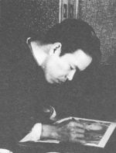
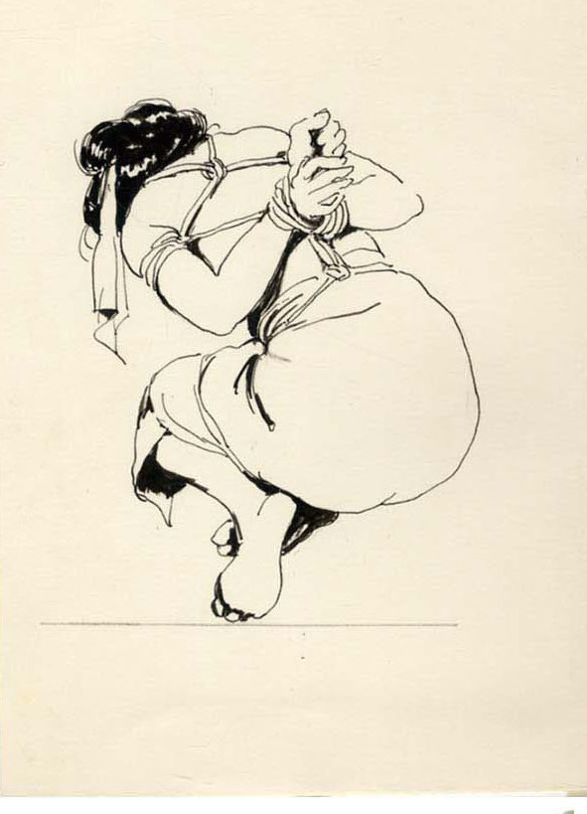
Minomura Kou (”Kita Reiko”)

Slide 6
Kawabata Tanako
Three models appear in the book. One of them is Kawabata Tanako.
Kawabata Tanako also tied herself, and had her ropework published in the magazine Kitan Club in 1953 (the same year that Beautifully Bound appeared). Interestingly, the same issue of the magazine contains a roundtable discussion amongst kinbaku models, also led by Kawabata Tanako.

Slide 7
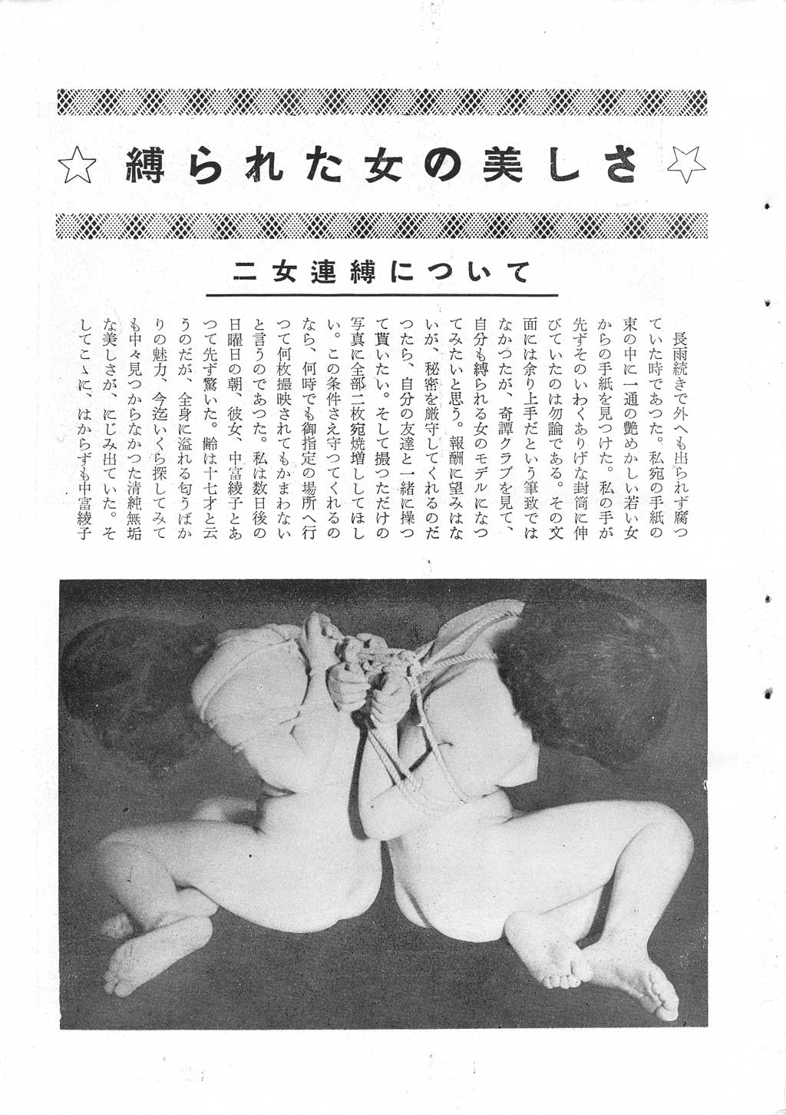
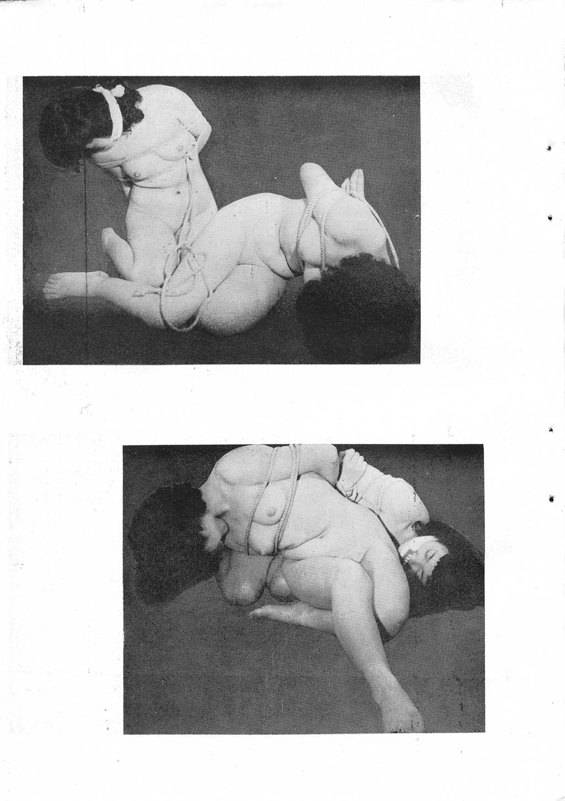
Rope: Kawabata Tanako (1953)

Slide 8
Kawabata Tanako – Kinbaku model
Kawabata Tanako has been called the first ”Kinbaku model”, as she appeared in the Kitan Club, May/June issue 1952, tied by Tsujimura Takeshi.
According to a 1955 article by Tsujimura reflecting on the history of his practice, the 1952 issue also contains the first uses of the terms ”kinbaku” and ”kinbaku model” in a magazine.

Slide 9
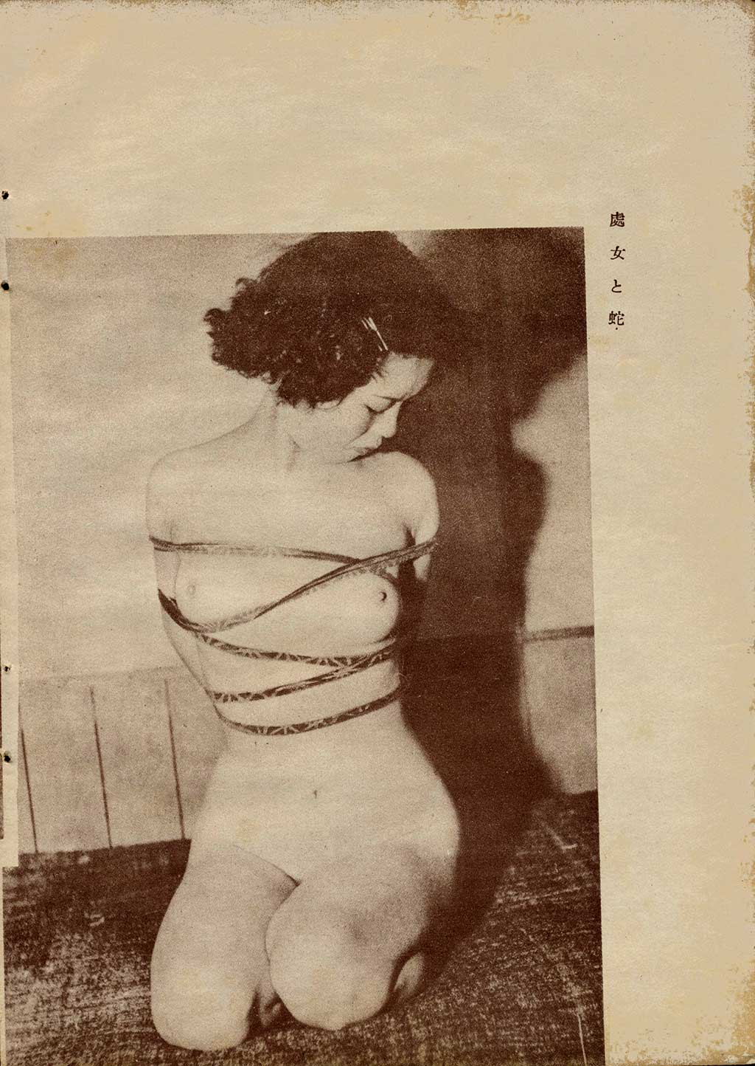
Kawabata in Kitan Club (May/June 1952)

Slide 10
Beautifully Bound: Texts and Images
Now the 16 images from Beautifully Bound follows, with a translation of the accompanying texts.
Translation by MN (London), commissioned and edited by Bergborg / Kinbaku Books (Stockholm)

Slide 11
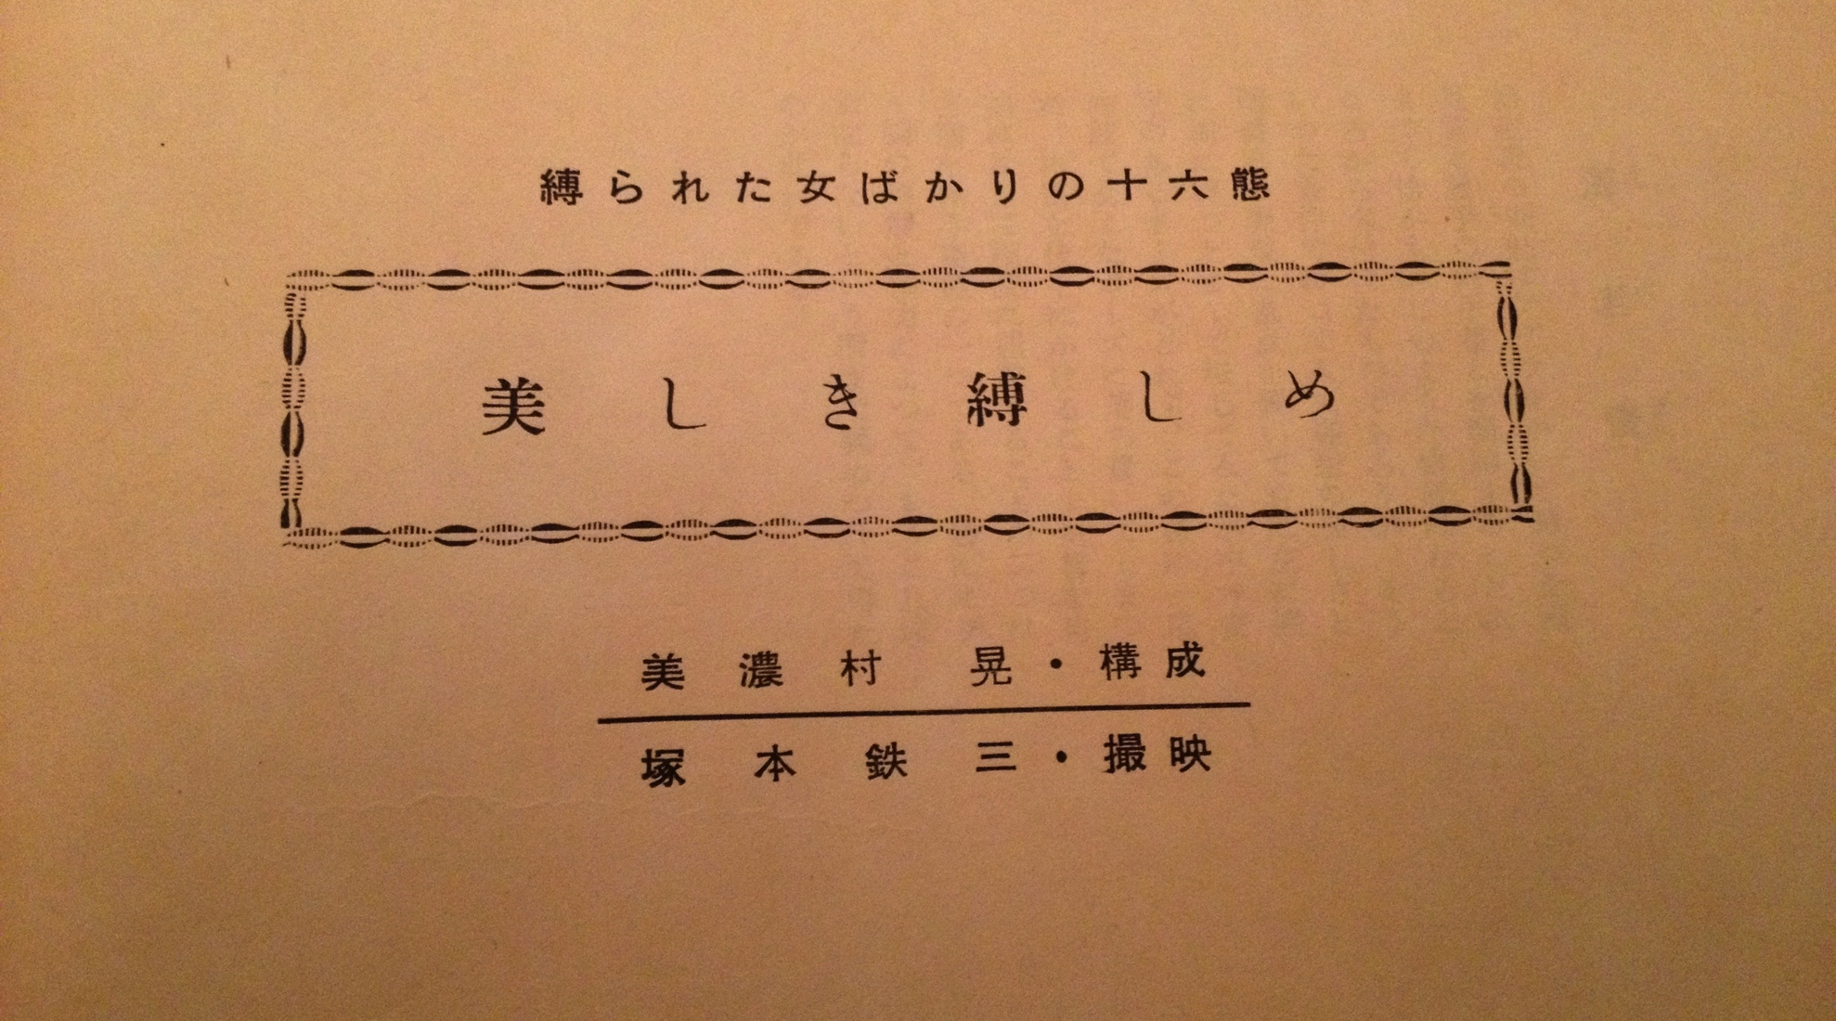
Beautifully Bound: Texts and Images

Slide 12
海老責 Ebi Zeme
Ebi Zeme or the “Shrimp”-tie probably got its name, because connecting the ankles and the back-bound wrists when sitting cross-legged gives the body a “shrimp” shape. I tied her up in such a position. With the focus on the beauty of the figure and on a feeling of tight binding, I rolled her to the right and the left, back and forth. It was hard to get a stable position, so I finally settled for a pose like this, in which both elbows support the body.
Putting weight on hands in the back and bending the legs like this, are two elements that cause pain. With the model’s understanding and cooperation, this is how far the body could be bent and tightly bound.

Slide 13
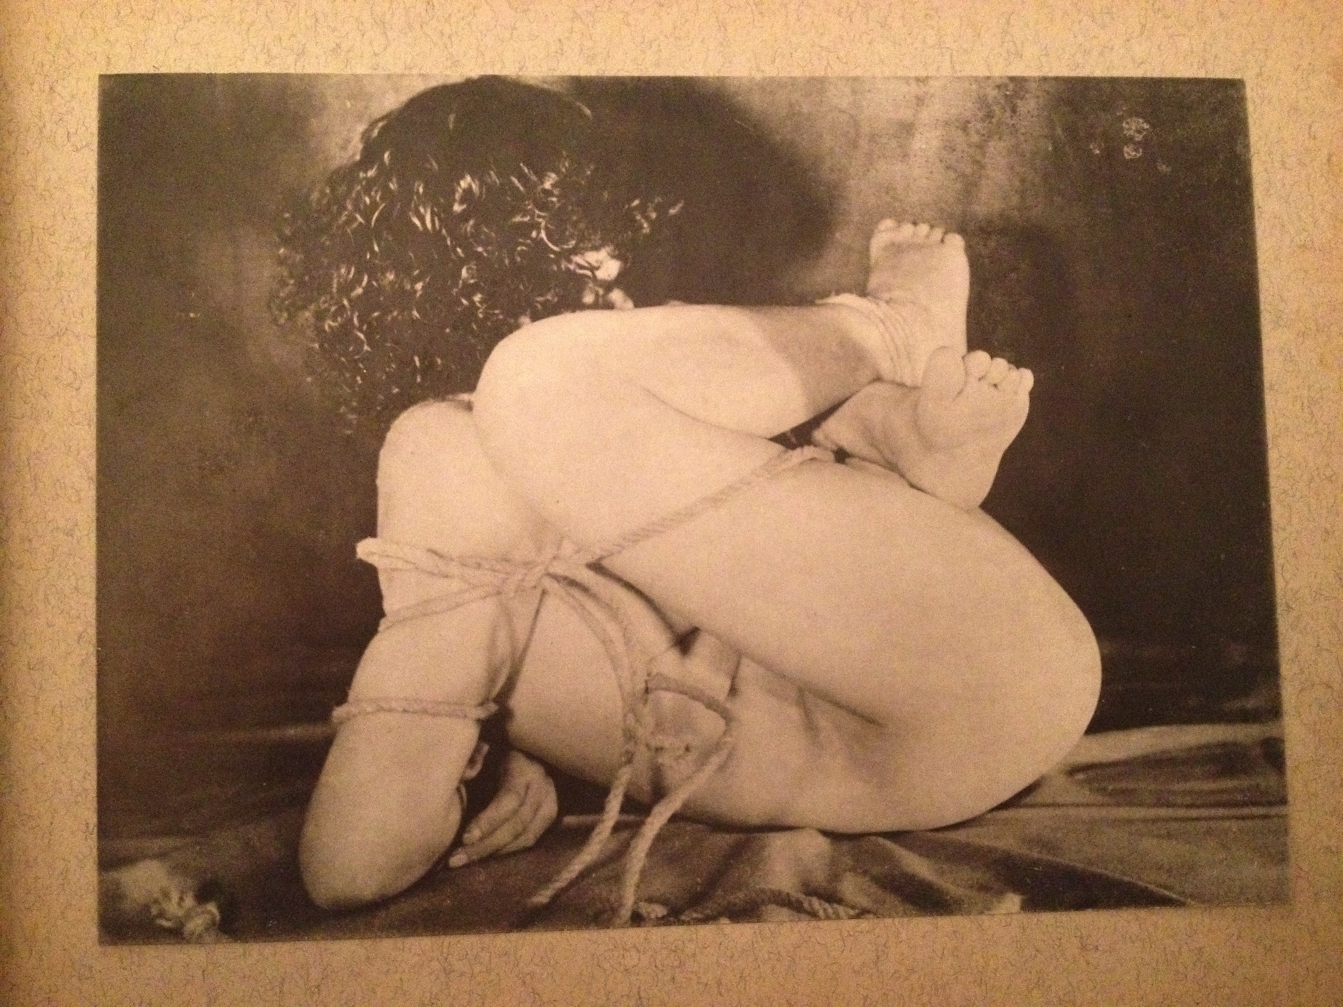
Ebi Zeme

Slide 14
高手小手 Takate Kote
This image is a little old-fashioned with the hands tied in the back and the gag using a traditional dotted cloth, but I included it among the sixteen photos anyway.
Starting from the hands in the back, I put rope by the neck, and lifted both wrists above the horizontal line. Thus, her head naturally leaned back and the face was upward. It shows how tightly the hands were pulled up.
Furthermore, I turned the leftover rope around and wrapped the upper arms twice tightly. So this is literally 'Takate Kote’. She was not able to look down, nor move her wrists. Only her legs are free, but this rather exposes a humiliating defencelessness. It is regrettable that the breasts are hidden as the expression of the back hands is emphasized in the photo.

Slide 15
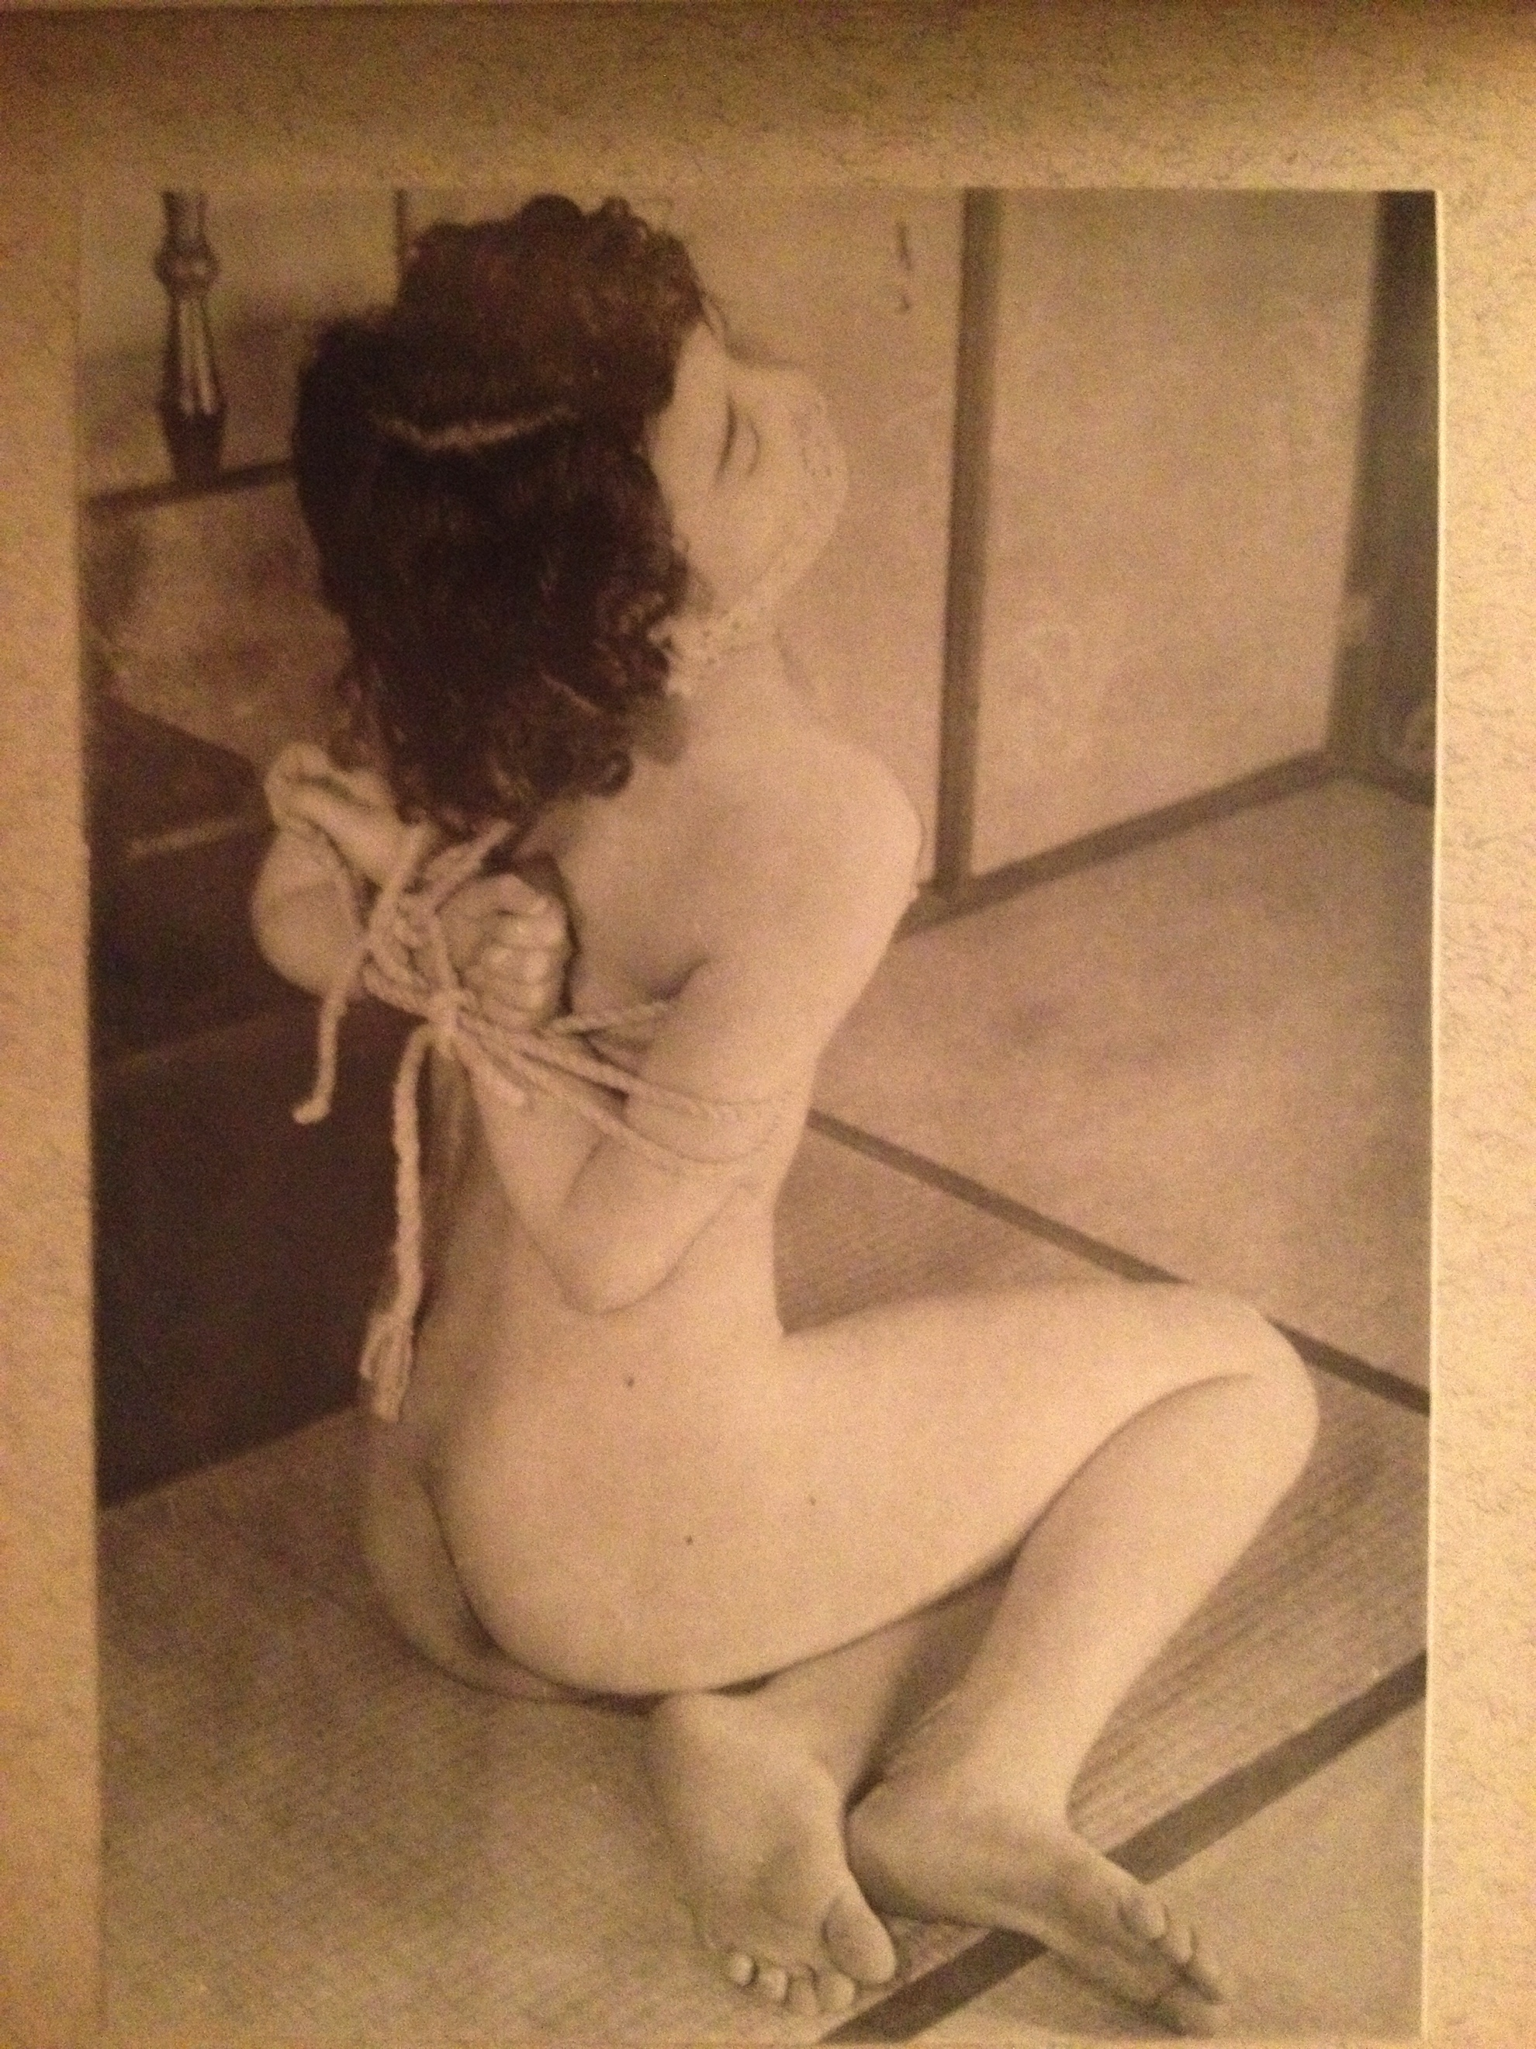
高手小手 Takate Kote

Slide 16
芋虫 Imo mushi (caterpillar tie)
The healthy light-brown coloured body looks like it would push my fingertip back if I put pressure on it. She is average built, approximately 158 cm height and 55 kg weight. The well balanced posture makes it impossible for her both to stand and to sit.
I tied the body lying down, fixating the hands in the back, and applied a gag. There was not the slightest sign of ruining the shape even when I folded her legs and bound them tightly.
While in this tie, I moved her lengthwise and crosswise, then we tried to aim with the camera from every angle, but I think this particular photo is most suited to call it 'a caterpillar'.
Anyway, I concentrated on putting rope on the lower half of the body to allude to the crawling of a caterpillar. I wonder, if it would have been better if I had done the same on the upper part of the body as I did on the lower part of the body, wrapping the rope around the chest.

Slide 17
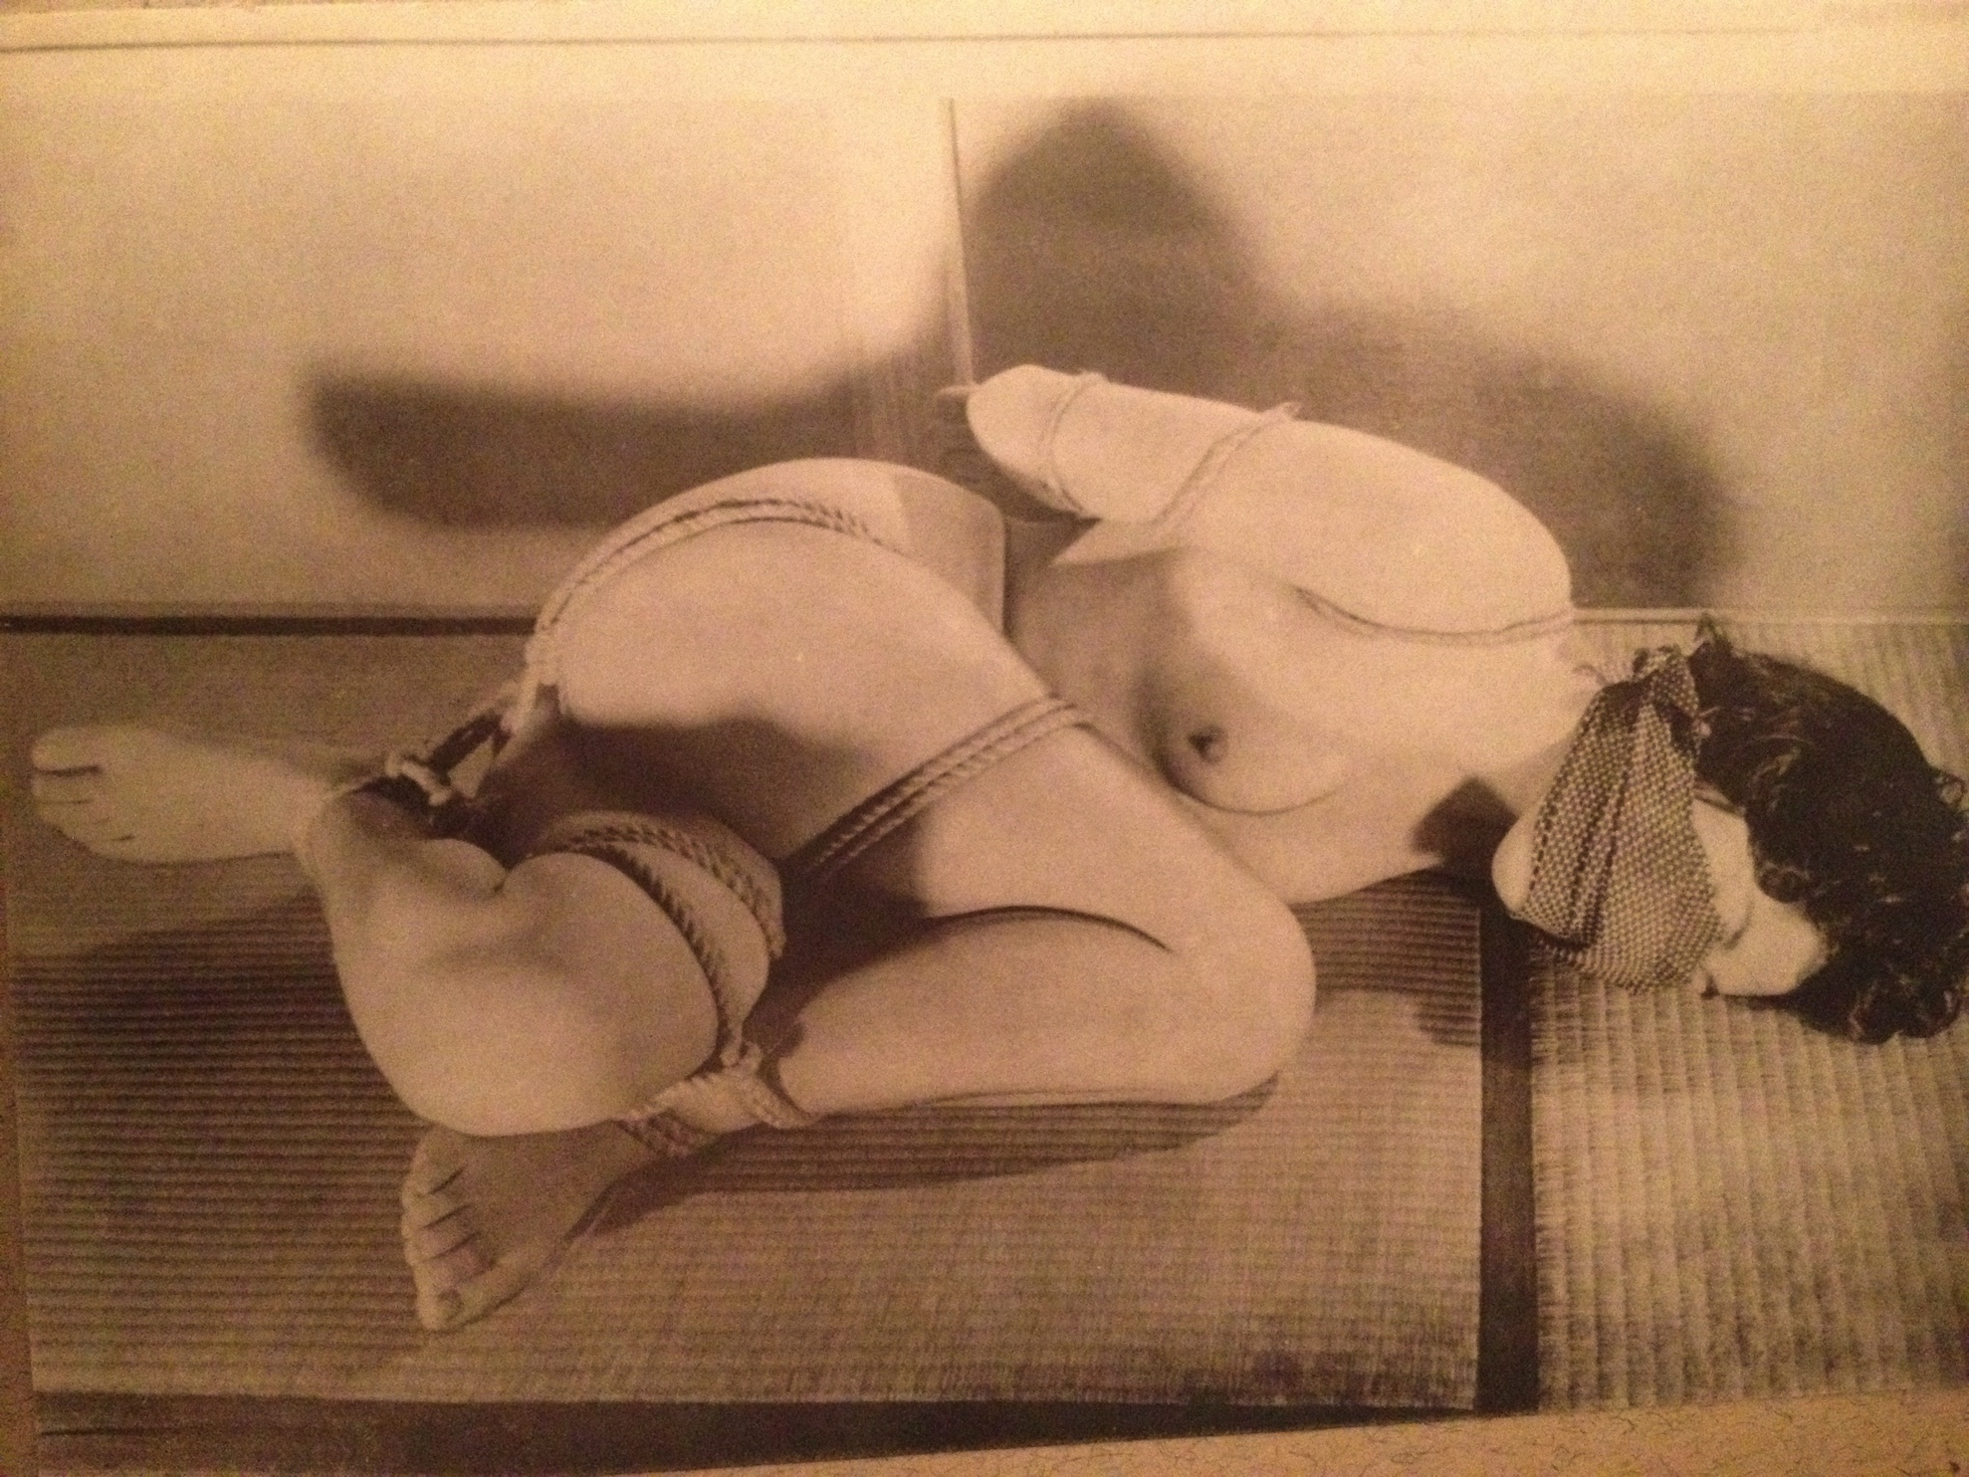
芋虫 Imo mushi

Slide 18
乳房 Chibusa (breast tie)
I wanted a Takate Kote and a gag, but I was aiming at the breasts as a central focus, so I put the double-rope over and under them. It is a pity that the rope on the back is a bit untidy, as it reduces the effect of the chest rope. It is a mistake that the black cloth used for the gag came down so close to the hands.
However, I think that there is something that oozes out from the figure of the tightly bound woman of this piece, which compensates for such failure. This is why I choose to include this photo.
Thinking of the effect of the tightly bound rope, there is more than enough room for letting imagination flow when it comes to the rope wrapped from the waist to the thigh.

Slide 19
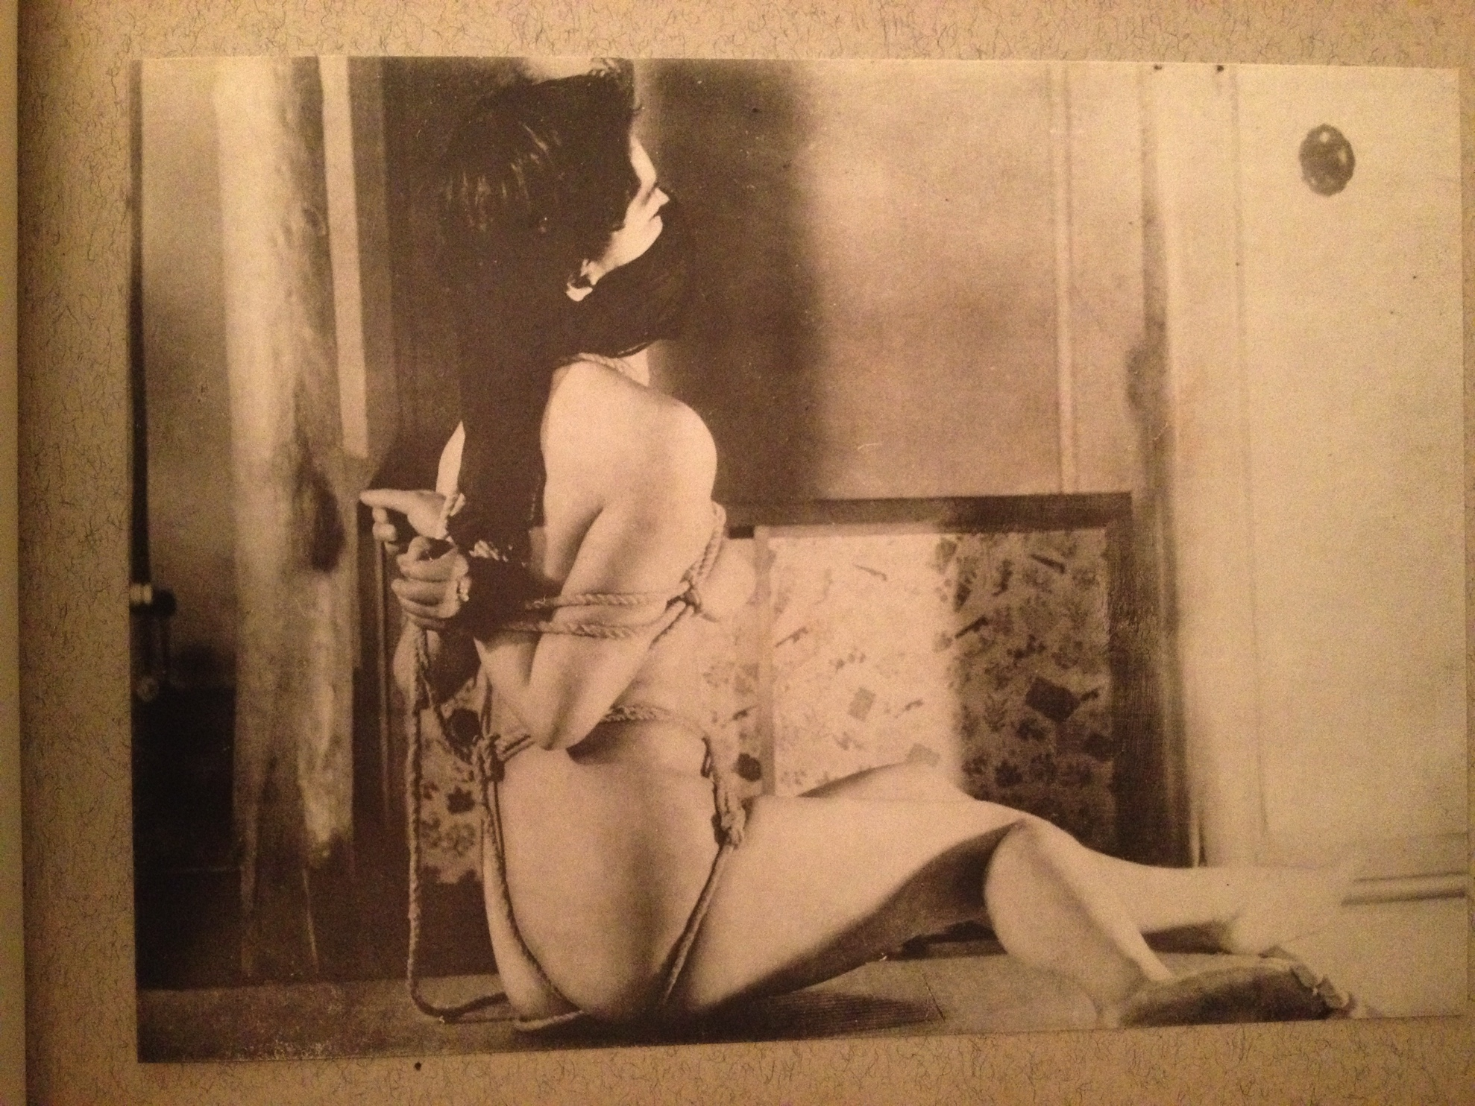
乳房 Chibusa (breast tie)

Slide 20
床の置物 Toko no Okimono (an ornament in an alcove)
An ornament in the 'Toko' (alcove)… but this is a living ornament, forged of a beautiful loving woman who is tied. This is a hands-behind-the-back tie, but not like the ordinary ones.
I placed the wrists at the centre of the body, then the rope goes over both shoulders to the upper arms. Tightening hard around the waist, so it becomes constricted, I continued on to the crotch, thighs and knees. She cannot bend forward, nor turn her face downwards, tied as she is, standing upright.
Bending at her right leg, arching her body to the left as much as she can, she has become an ornament in the alcove.
Perhaps it is impolite to describe the living body of a woman as an ornament, but this young woman may take secret pleasures and have unbridled pride in her naked body being looked upon and appreciated by you all.

Slide 21
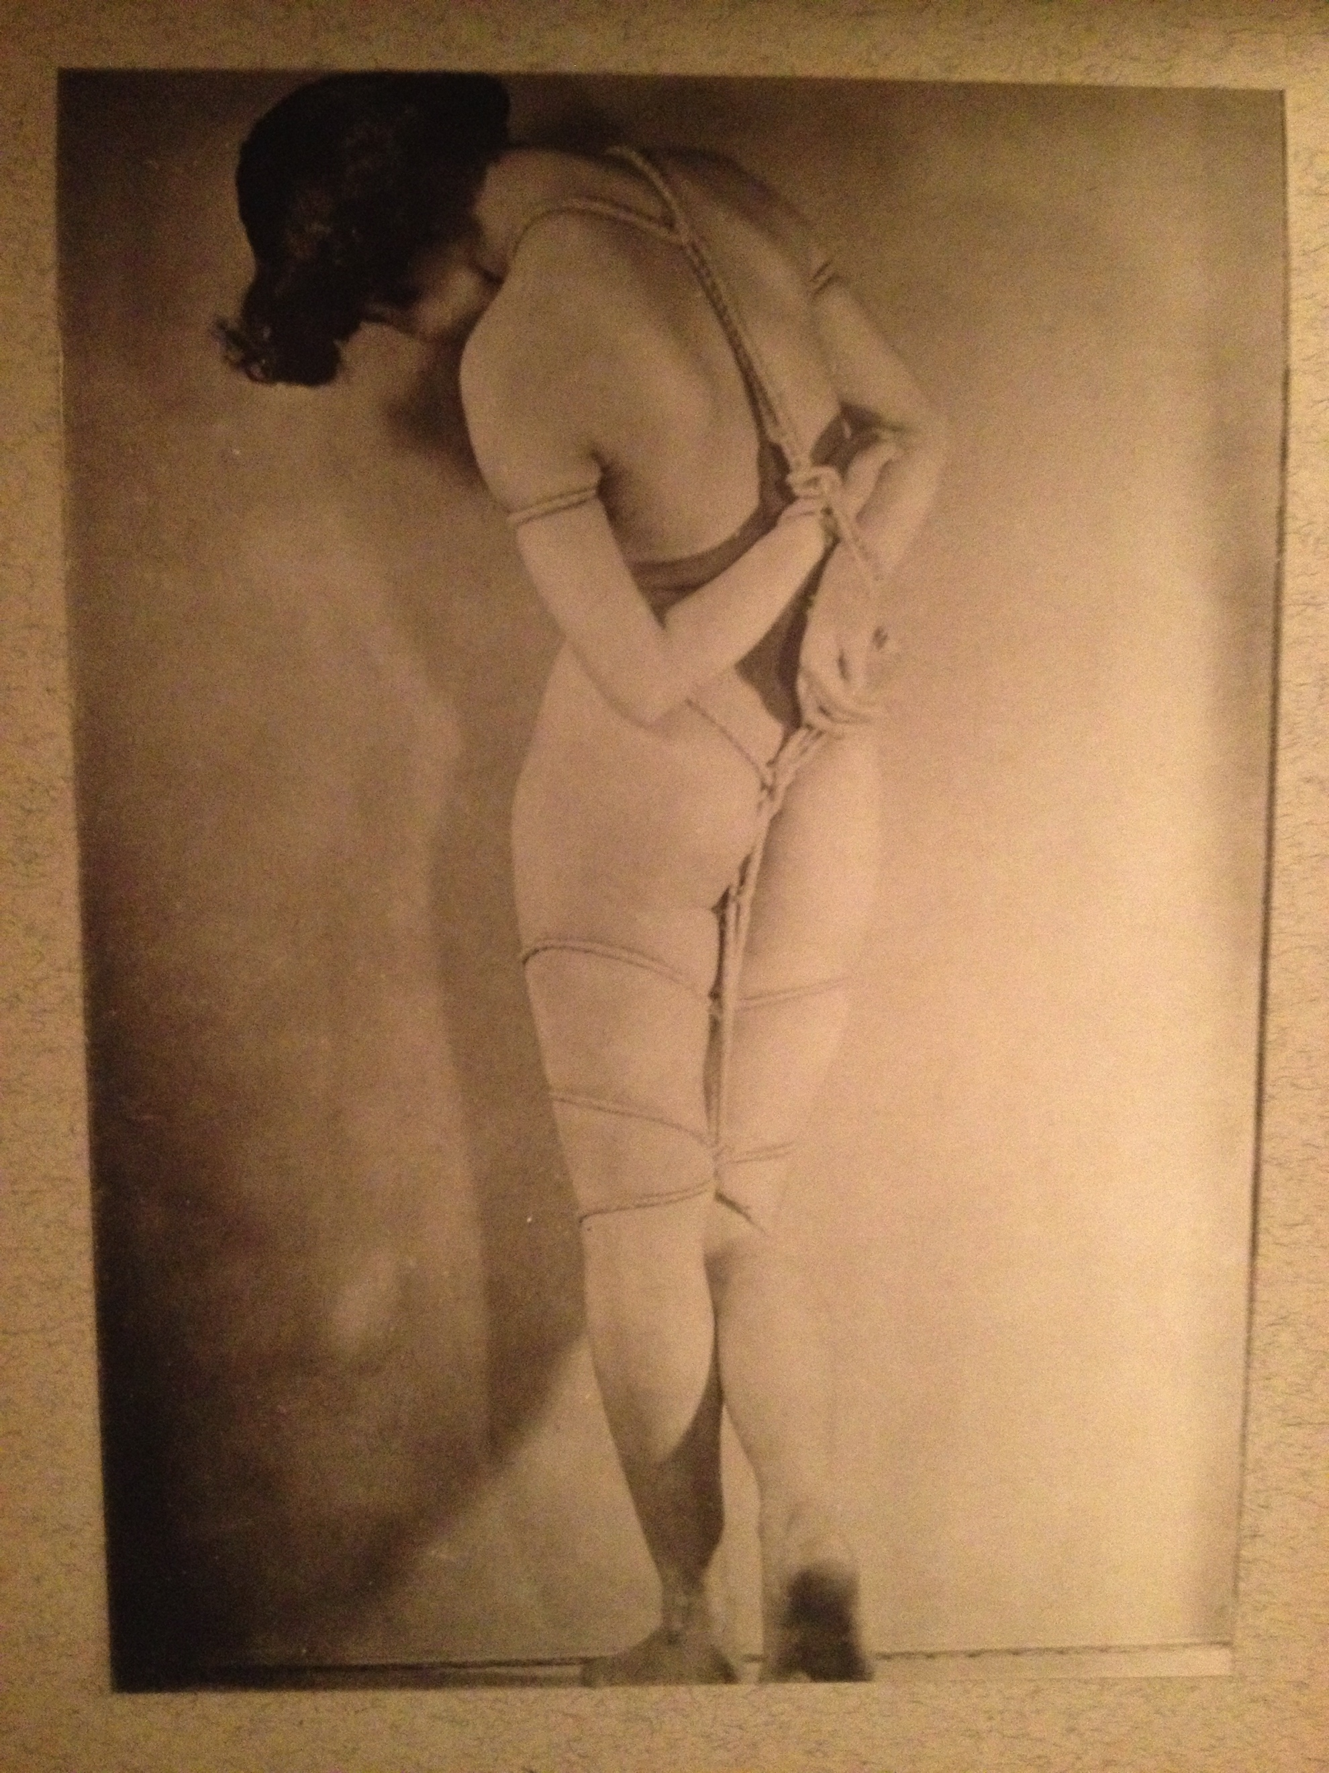
床の置物 Toko no Okimono (an ornament in an alcove)

Slide 22
紅と白 Aka to Shiro (Red and White)
This image shows a woman in a more difficult and painful pose than any of the previous photos. The red colour of the Nagajuban [worn under the kimono] and the white colour of her skin… unfortunately this photo is not using 'Technicolour', but it reveals the atrocious torture of a woman hanging in midair on a column. This is by no means a fake nor a trick, this is a truly serious pose in which the model made an effort and cooperated until she reached a state of presyncope.
This photo is a gem that has been carefully preserved and not shown to the outside world until now. I decided to share this image to celebrate the publication of this album. Despite the fact this is the only photo in this album in which the model is clothed, I am confident that no other photo will outdo it. After several hours of wading through spiderwebs and dust, in the end this was the most precious and satisfactory piece I got.

Slide 23
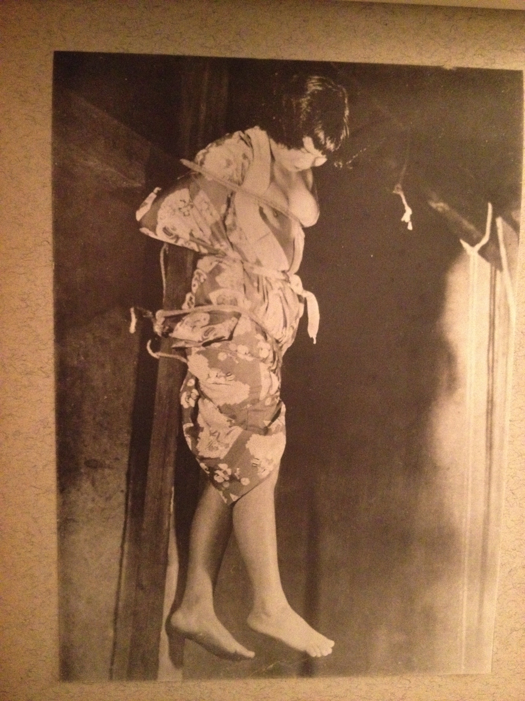
紅と白 Aka to Shiro (Red and White)

Slide 24
目の綾 Me no Aya
The model is posed between the telephone and the vase, half sitting on the carpet rug with her hands behind her back, attached to the ankles. Her legs are open in order to maintain stability, forming an elegant triangle. I placed a hanging scroll similar to that of an Ukiyo-e print above her.
The position was created by breaking the equal balance and lowering the right wrist. The model required the gag to be removed as it made it difficult for her breath and keep such a posture simultaneously.
If I didn't use rope as a help, she could not have held the pose for more than ten seconds. In other words, it may be said that this piece shows the maximum effect of just a single rope.

Slide 25
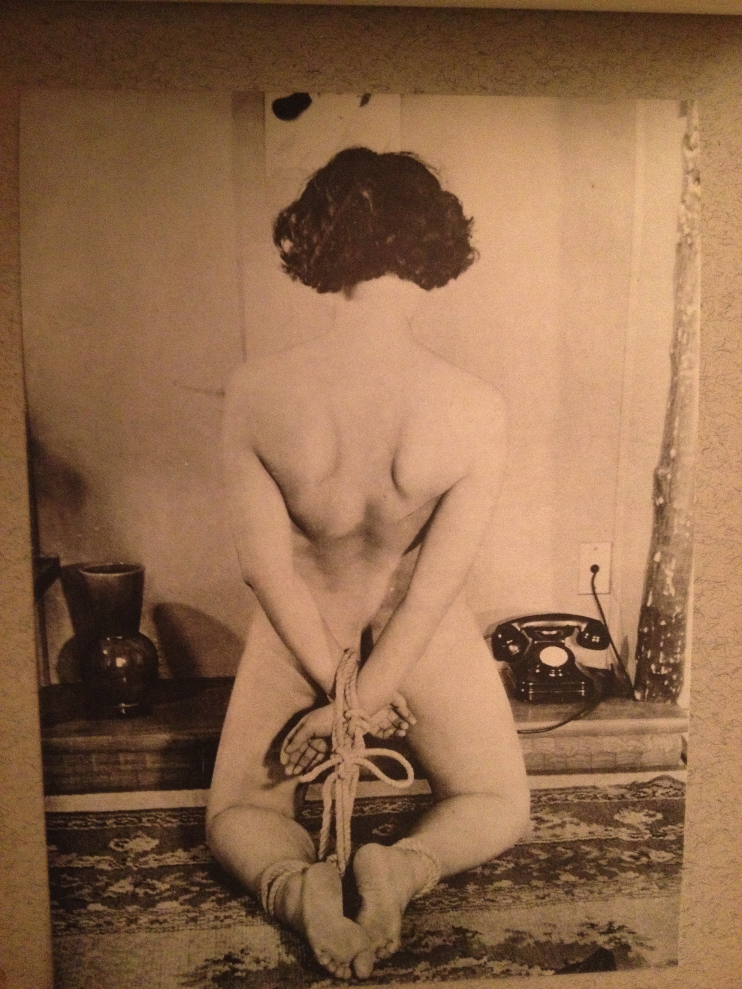
目の綾 Me no Aya

Slide 26
雁字搦目 Ganji Garame (Immobilizing tie )
The naked woman is tied firmly from the chest to the ankles. Much rope is used, but with an attempt not to lose the beauty of the model’s body. I avoided rope running over the breasts and the buttocks.
If a body doesn't have a voluptuous figure, some faults appear unsubtly when making this kind of pose. But the model has a body weight of 55 kg, and as is expected there are no such faults shown here at all.
She is wearing rope all over her body, but there is no feeling of being bothered to be seen. There is a beautiful line –a shape like two of the Japanese alphabet 'Ku’-mark, or like a lightning bolt. As the black colour of her hair and the gag are marked as key points in the picture, this pose reminds of a beautiful white lily blooming on the mountain shade.

Slide 27
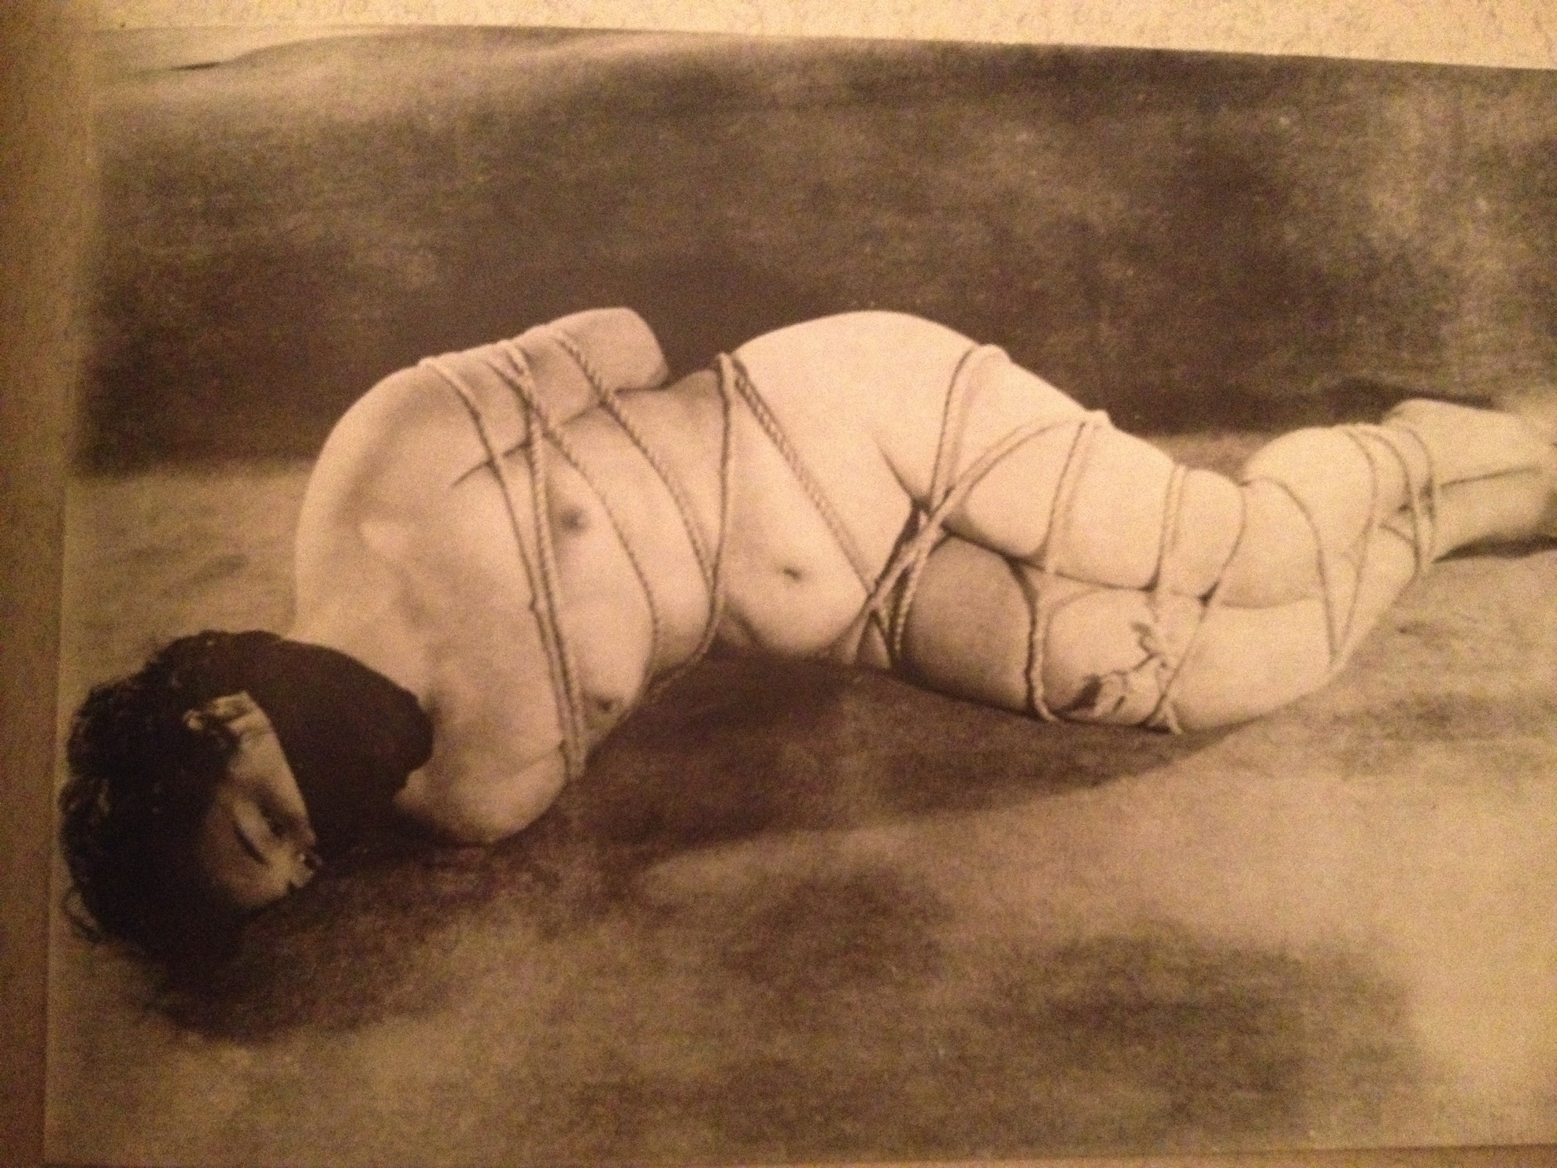
雁字搦目 Ganji Garame (Immobilizing tie)

Slide 28
足枷 Ashikase (fetters)
A different method to the iron chains of the Middle Ages and to the wooden implements in the Tokugawa period, I attempted to substitute these items with a bamboo stick which is obviously viewed as a modern item. At first I was uncertain, but since I was going to tie up a modern girl with permed curly hair, I thought it would like to create the right atmosphere in the instance. To start with, I requested her to partly take off her slip.
This is fantasy that a girl is held in captivity in a room of Zashikirou [closet].
This is a pose of complete helplessness induced by tight binding which does not allow the body to move at all. The tight binding created by the bamboo and the rope, although you might not understand without experiencing it first hand, would leave the victim in extreme pain and also give visible marks from the tight binding itself.

Slide 29
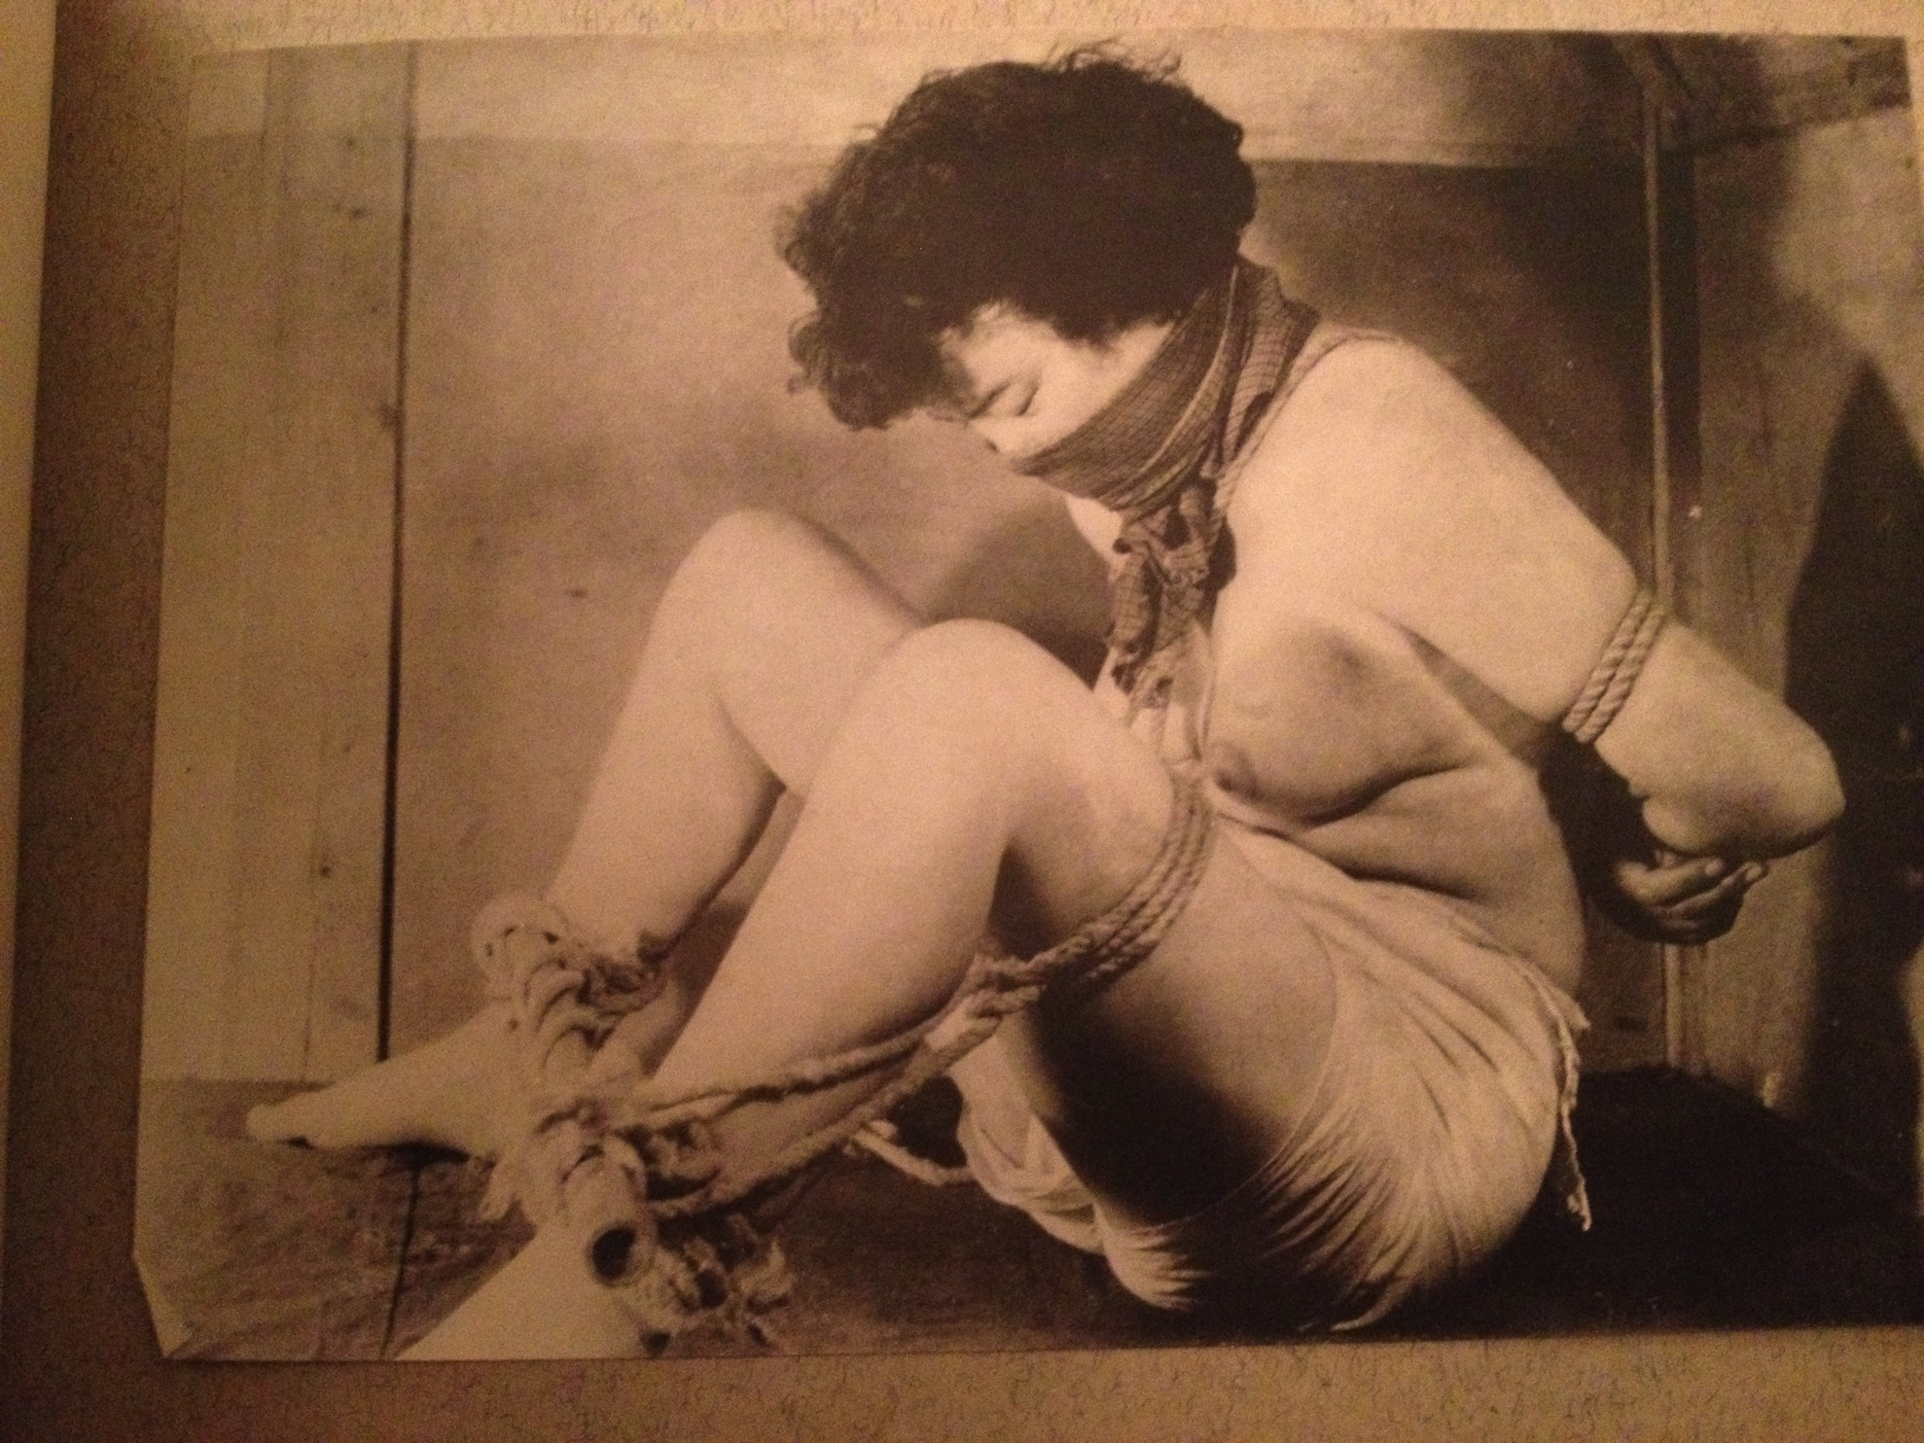
足枷 Ashikase (fetters)

Slide 30
鞭打 Muchiuchi (whipping)
The ample flesh that a belt seems to bounce back off when I strike it, the bulging twin hills of the buttocks. Who doesn't feel a desire of a blow of the belt to this warm, blood-circulating skin? She asked for a gag of a big cloth to be used on her, almost covering her nose, as if she didn't want to be heard screaming or groaning after every single lash. She made a pose throwing her body as if saying “please whip me, wherever”.
Then, in one blow, the buckle of the belt hit her elbow, made a wound there and blood began to ooze from it. Still she begged for more “please whip me more, whip me more”. I took a dozen of photographs, which show different figures, picking up this piece from the middle.

Slide 31
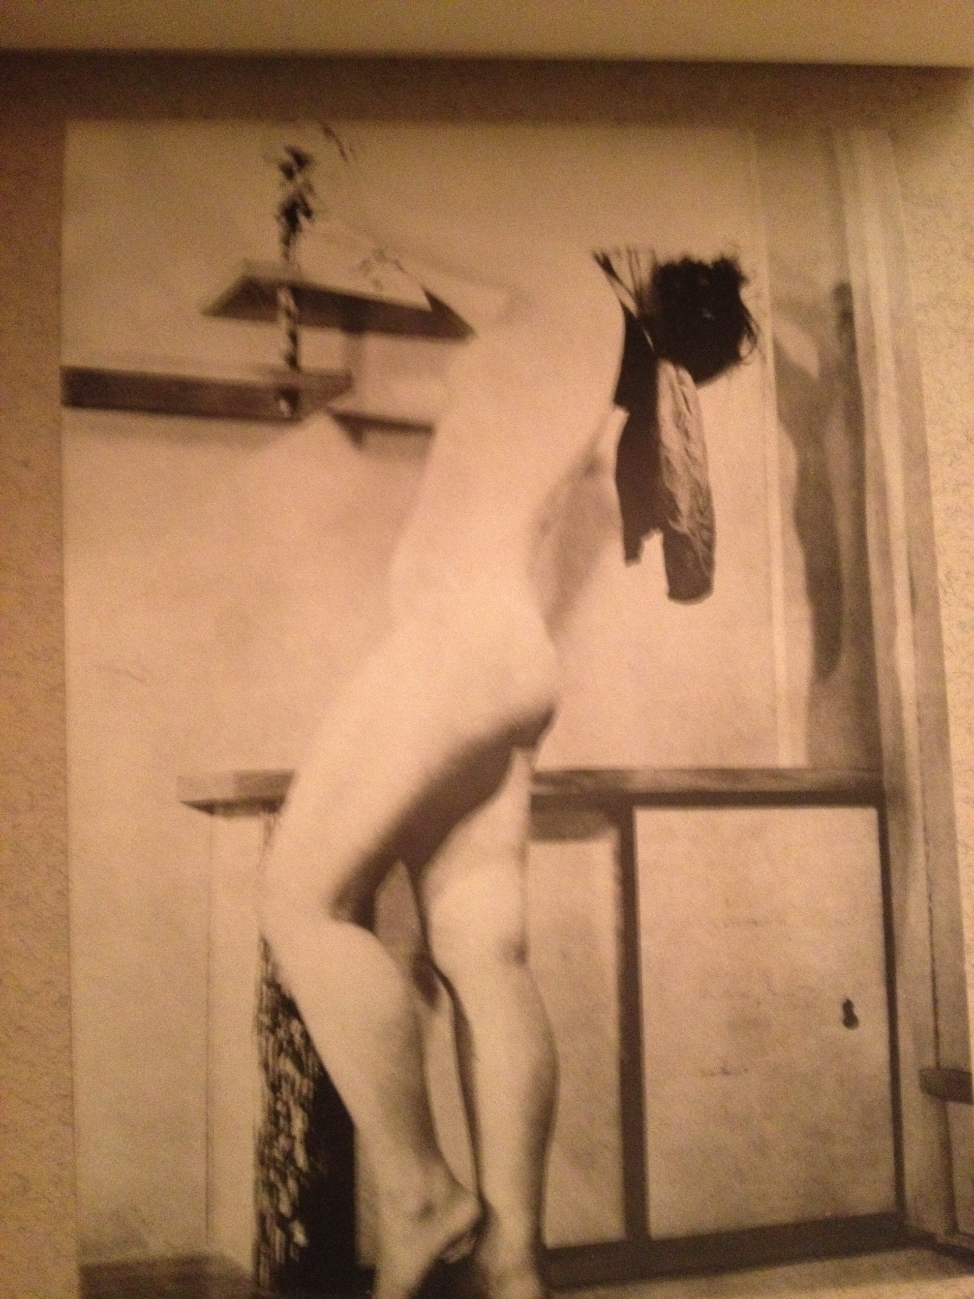
鞭打 Muchiuchi (whipping)

Slide 32
蝋燭 Rouyoku (candle-play)
After hanging her upside down from the beam, I tied her hands behind her back and dragged her up the stairs. She said she still had a pain in her ankles, and struggled playfully, saying 'No, no'. But I lit the candles and placed them on her shoulder and knee.
'If you move, hot wax will drip onto you. Keep staying still as you are, be patient until the candles are burnt and gone.'
'It feels hot, hot.'
'If you move, I will place this new candle on your body, too.'
As she moved her leg unintentionally, the drops from the candles run down from the knee to the instep.
'So, I will apply a gag as a punishment for moving your body. Then let's start the genuine candle torture.'
Her confession afterwards: 'It was very pleasurable that hot wax ran down on my skin. I felt the thrill of being scared.'

Slide 33
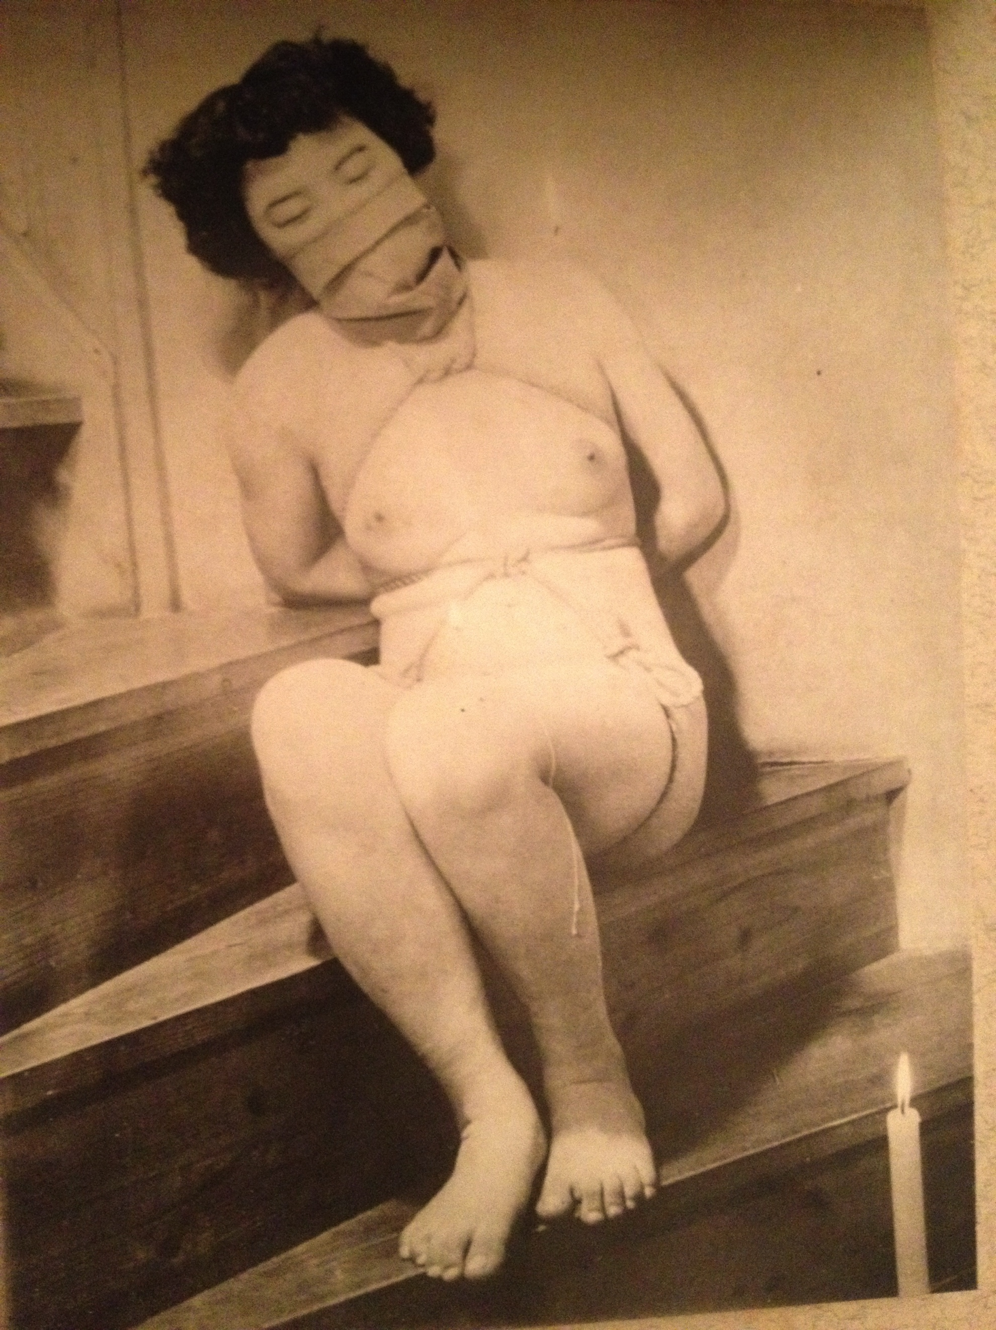
蝋燭 Rouyoku (candle-play)

Slide 34
滑車吊 Kasshazuri (pulley suspension)
To support one's weight of more than 40 kg by one rope on the naked body is painful. Furthermore, suspension will create a situation where all resistance is futile. Tentatively I put rope on various places on the woman's body with the hands tied behind the back, then lifted her by using a pulley. But sometimes she was not able to bear the pain even before her body was raised in the air, or other times there was a lack of beauty as a figure. I got this photography as a result of having tried more than ten times.
Therefore, I hope you all understand this is the one which was selected among over twenty pictures, which took several hours to shoot before and after this moment. Please appreciate this piece for it.

Slide 35
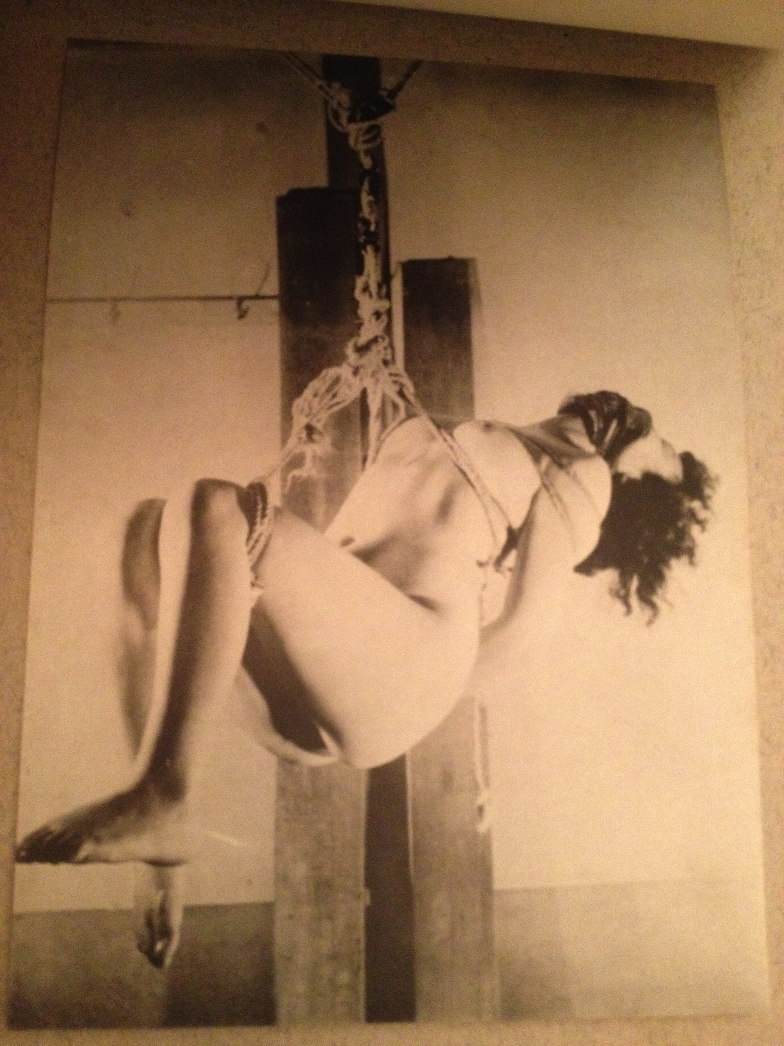
滑車吊 Kasshazuri (pulley suspension)

Slide 36
観念 Kannen (surrender)
The beauty of the moment when a woman surrenders by being tied until her freedom is completely taken away, the transfer of freedom over her own flesh and giving it to the other person, being helpless in the end after begging, resistance, being humiliated…
The rope which is placed across her chest is taken from behind her back where it is bound around her wrists tightly, then brought back under the breasts with a knot there, wrapped tightly around the waist, so that a triangular shape is formed around her navel. Furthermore, the rope goes under her crotch from the front, tied at the point where all the ropes come together behind her back. Even the freedom to just stand up is not given to her.
With the hands tied behind the back being the central focus on the upper body, and involving both legs, this is a satisfying posture for the beauty of surrender, melting into the harmonious feeling of being suppressed.

Slide 37
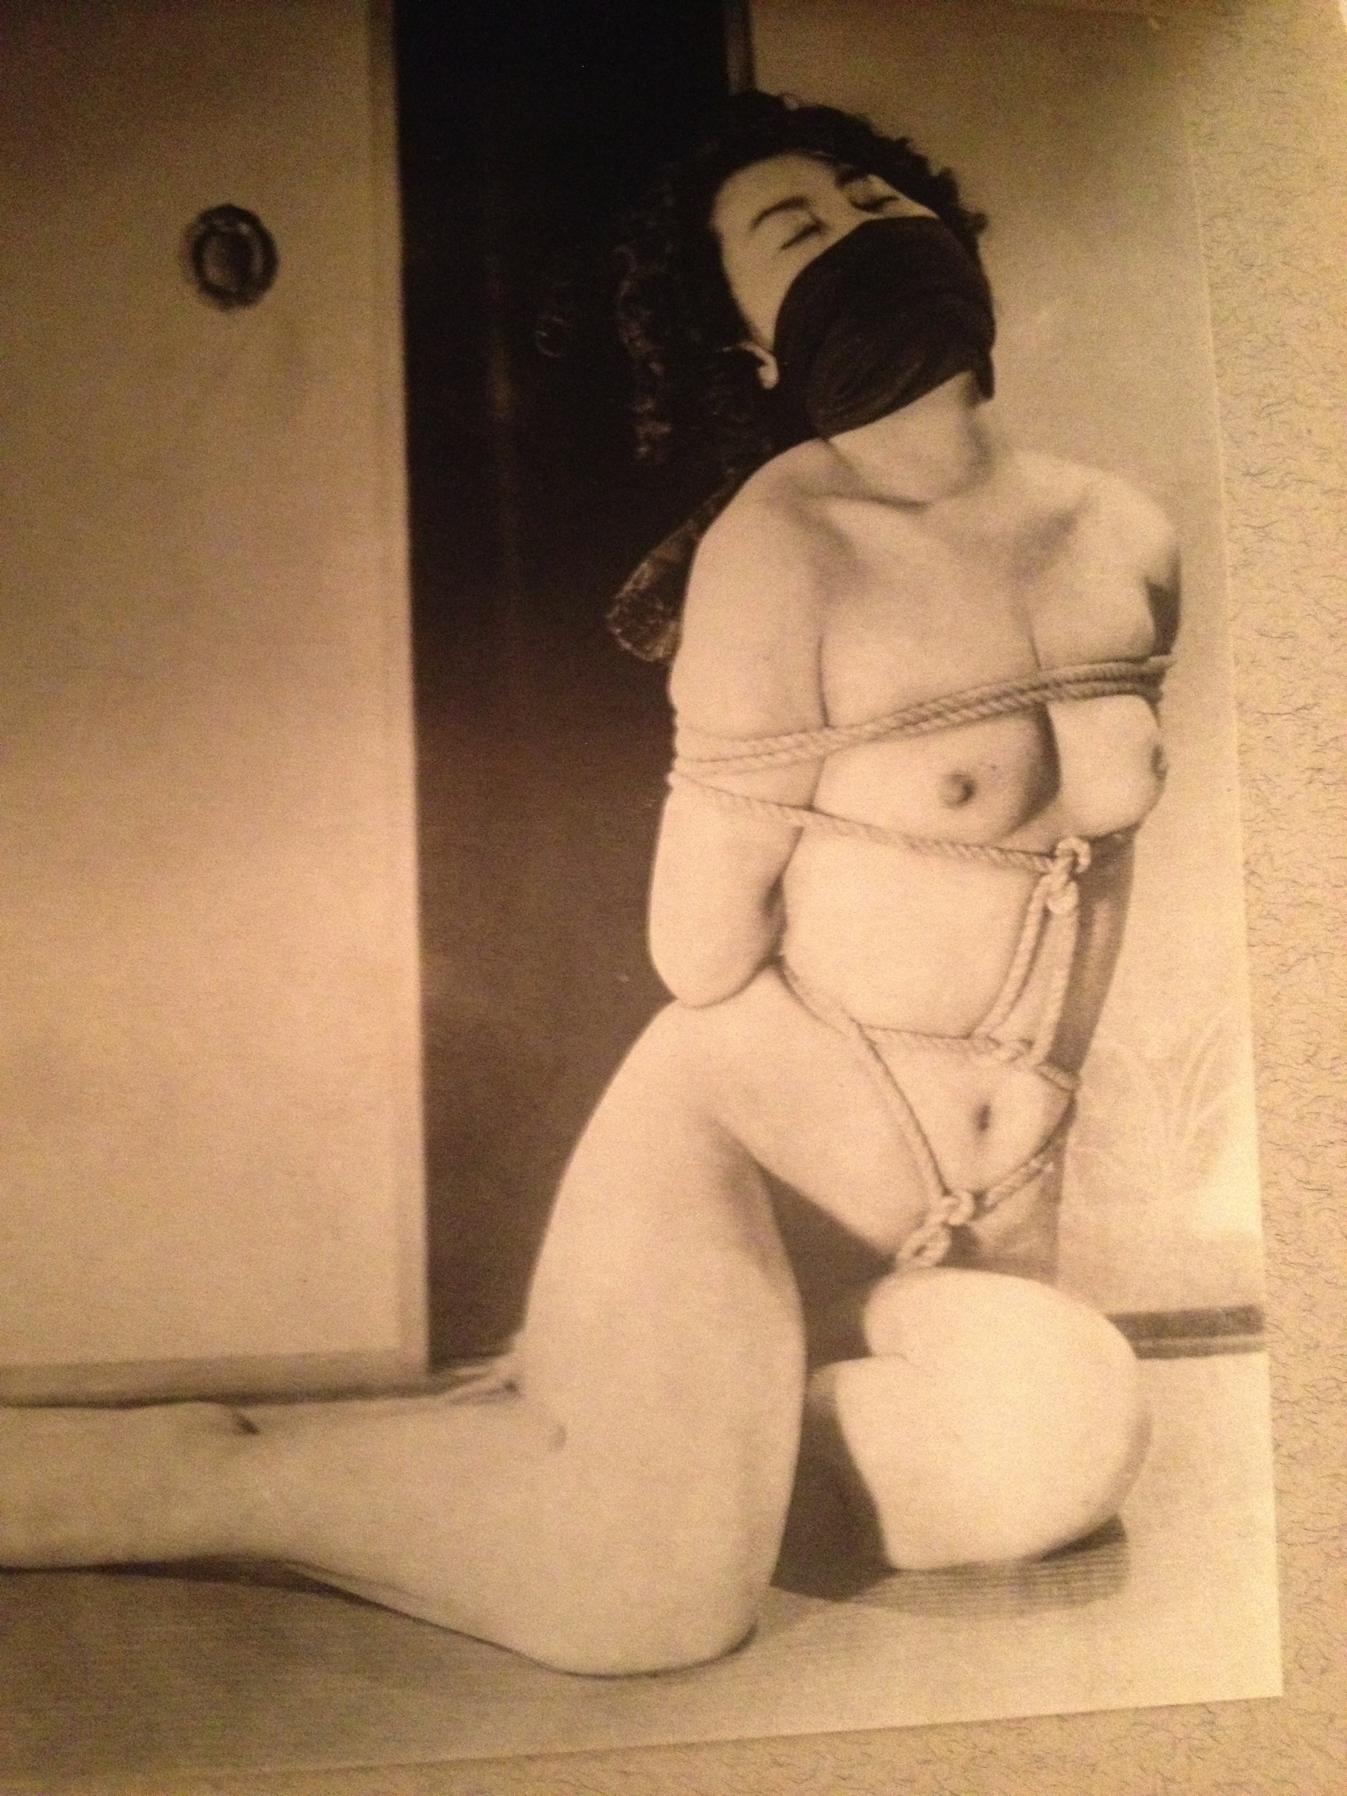
観念 Kannen (surrender)

Slide 38
荒縄 Aranawa (straw rope)
In the backyard of the solitary house far away from the suburban area, the dusk is filled with the evening haze, this is a fiesta of torturing a woman's body unfolding on the small veranda. All around is in slate grey colour, except the body of the woman sparkled white, which is tied up tightly with rough straw rope. Both legs are turned and twisted as if they are expressing agony in her heart.
Even before she finished her words – ‘put something in my mouth and wrap it around’ - I forcibly put a piece of cloth in her mouth and made her wear a cloth gag. I didn't notice that it accidentally covered her eyes because the sun had gone down by then.
After one photoflash, I slowly began to put my camera away, wondered how long she would last like this, being left on the veranda in the dark.

Slide 39
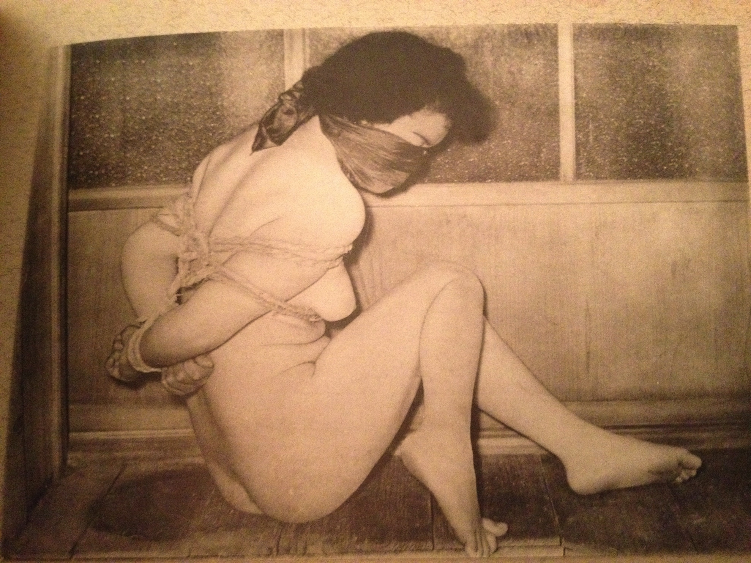
荒縄 Aranawa (straw rope)

Slide 40
犠牲台 Giseidai (an altar)
A beautiful sacrifice on an altar, as the proverb says - like a carp on the cutting board. “How to be cooked, it is entirely up to all of you” - this is her kind words. “Pinch or tickle me as you like.” As she is being sacrificed, she has prepared herself for it from the beginning, thus letting her naked body be tied and placing herself on the surface which is one level higher from the floor. She said: “My thighs, breasts and arms are aching and throbbing for pleasure, they are waiting to be cooked by you. Please finish me off at once. With my wrists tied high behind my back, the pain they are giving me is unbearable.”
Please someone try to come up with an idea of how to torture her next.

Slide 41
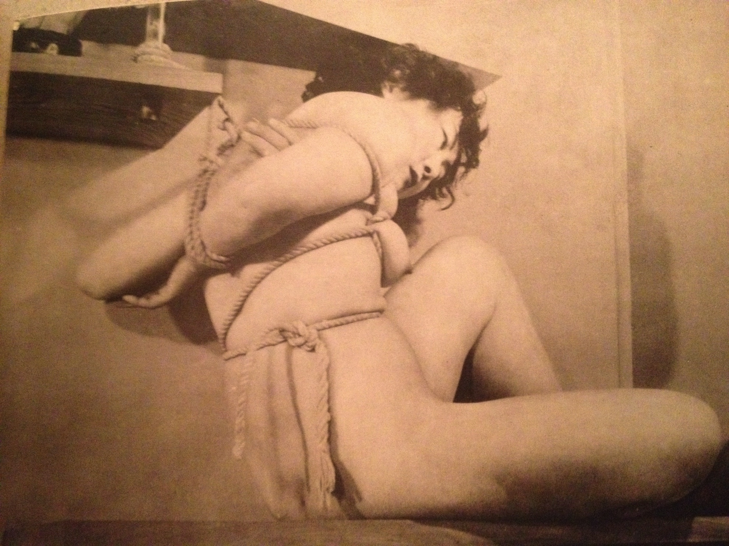
犠牲台 Giseidai (an altar)

Slide 42
猿ぐつわ (a gag)
In the pose it looks as if she is throwing out her chest as she lays on her back with her hands tied behind her. This model has just become eighteen years old, her body silhouette is still developing, so we can not expect a voluptuousness from the breast and the waist of a woman.
I intended to emphasize the beauty of her profile with a gag, using a cloth to cover her nose and mouth.
At first I pushed a handkerchief into her mouth, then covered it with pieces of random pieces of cloth I was able to find around. However, because those pieces of cloth were not like one long towel, the extra bits and pieces were squeezed out and it made it look really flabby visually. This is regrettable.
I wonder if something like a traditional Japanese tenugui might have been better.

Slide 43
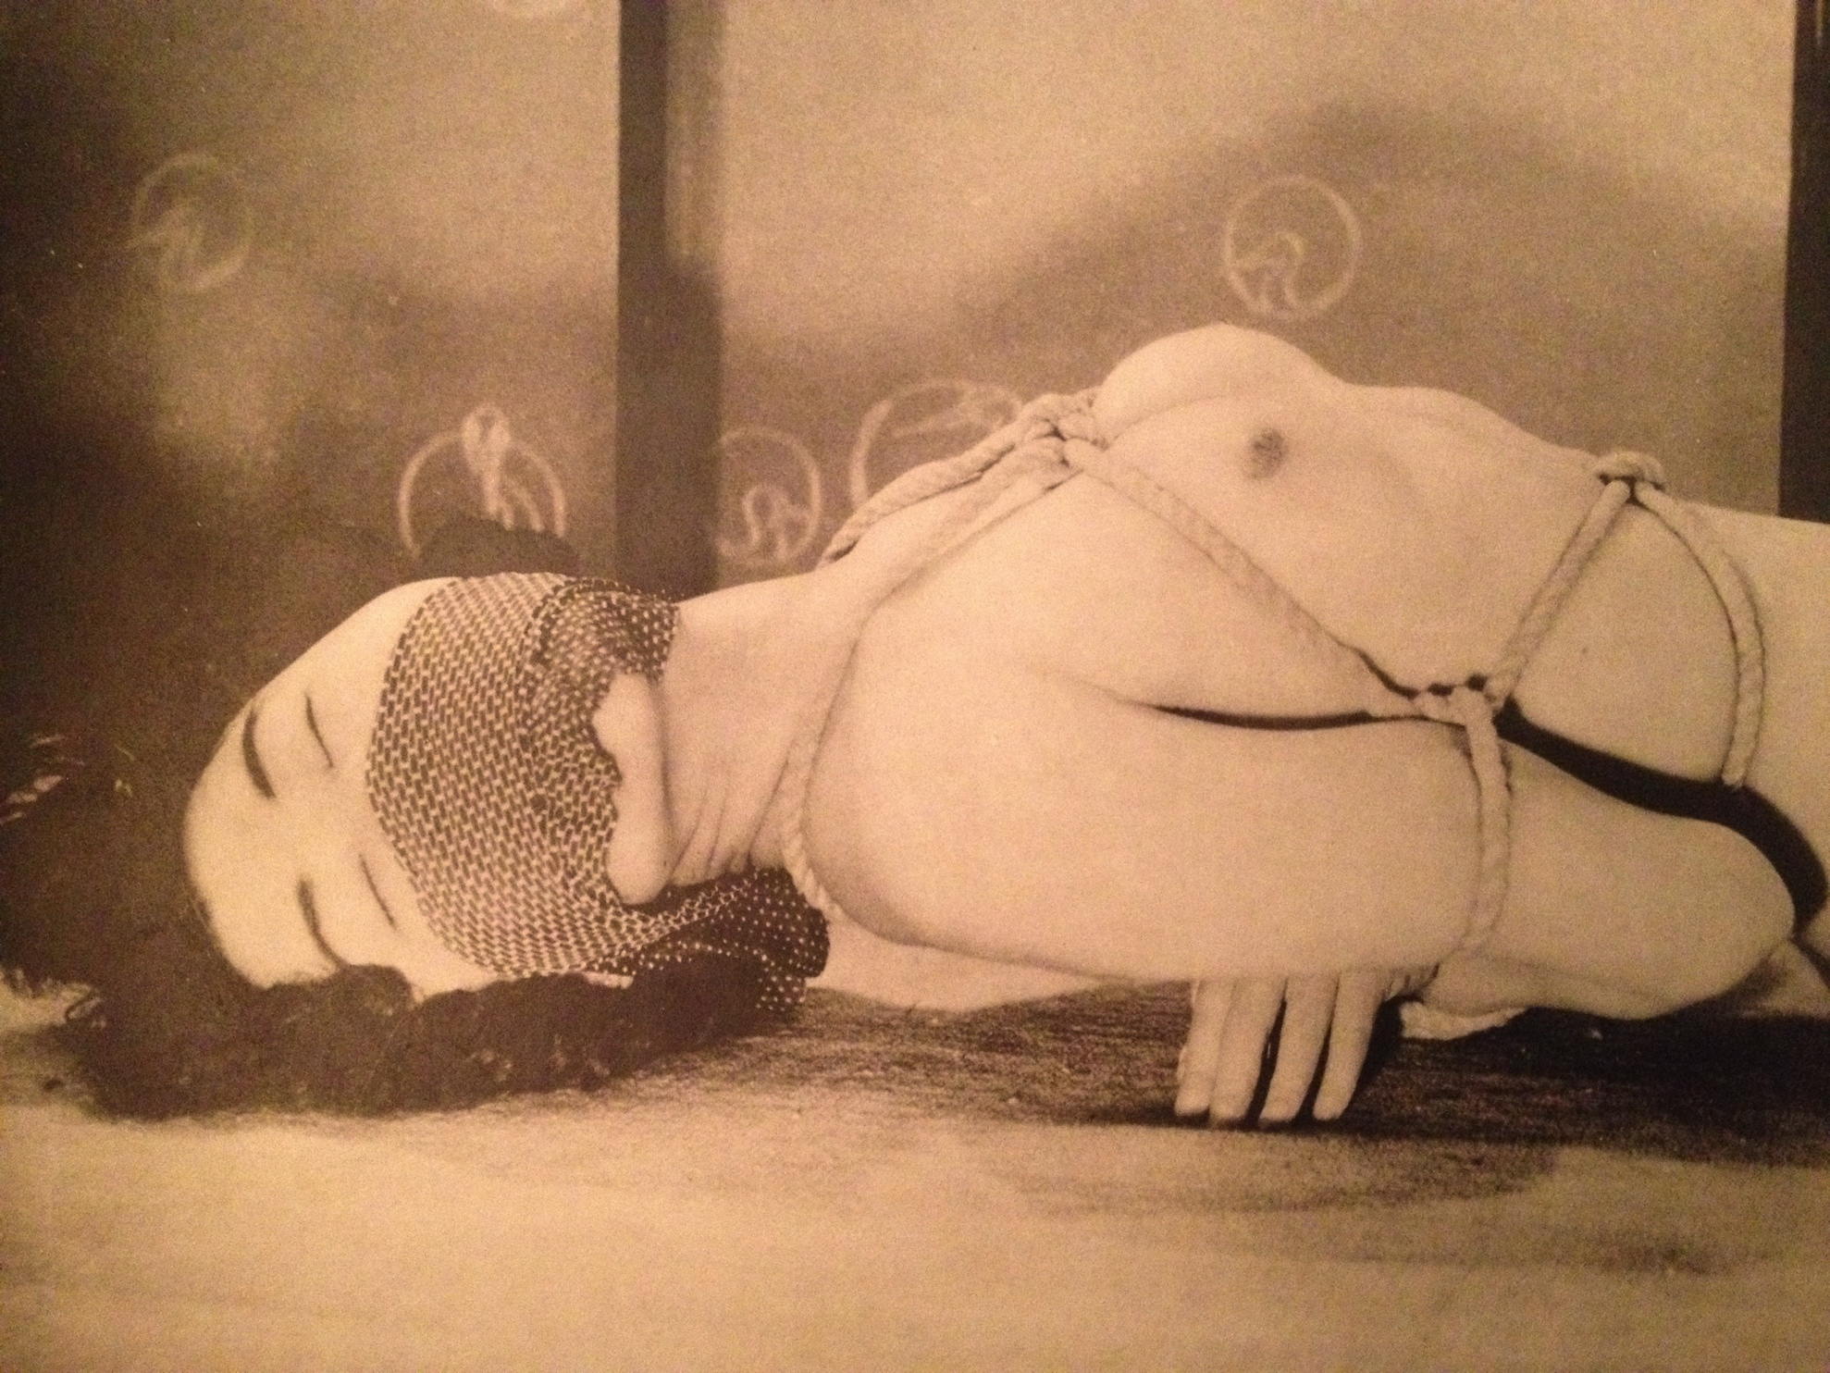
猿ぐつわ (a gag)

Slide 44
The Kinbaku Books blog
Beautifully Bound is one of the treasures in a large collection of Japanese Kinbaku material in Stockholm, Sweden. It contains many hundreds of items, spanning from original sketches by Itoh Seiu to the latest DVDs of contemporary bakushi.
Some of the printed material is presented with free access on www.kinbakubooks.wordpress.com

